Slide 1

Arduino
Soil Humidity Control System
Zagoras Konstantinos dai19242
Tsaganidou Mariadai18256
Contact us: daiXXXXX@uom.edu.gr

Slide 2
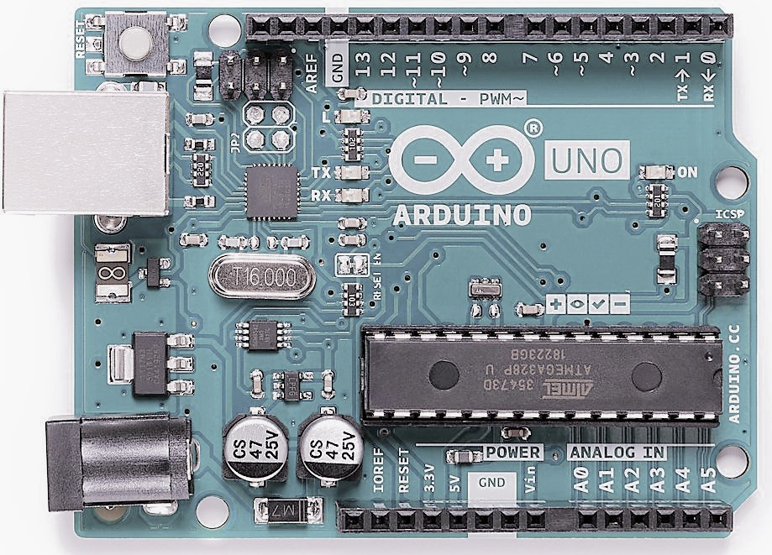
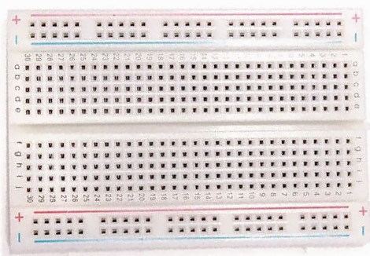
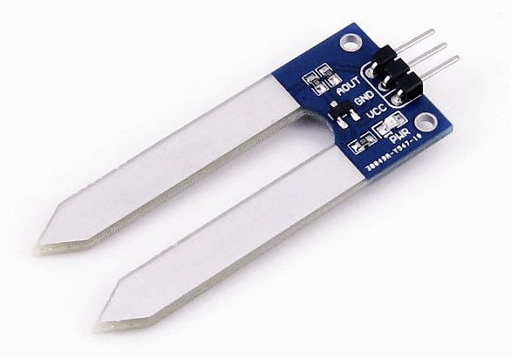


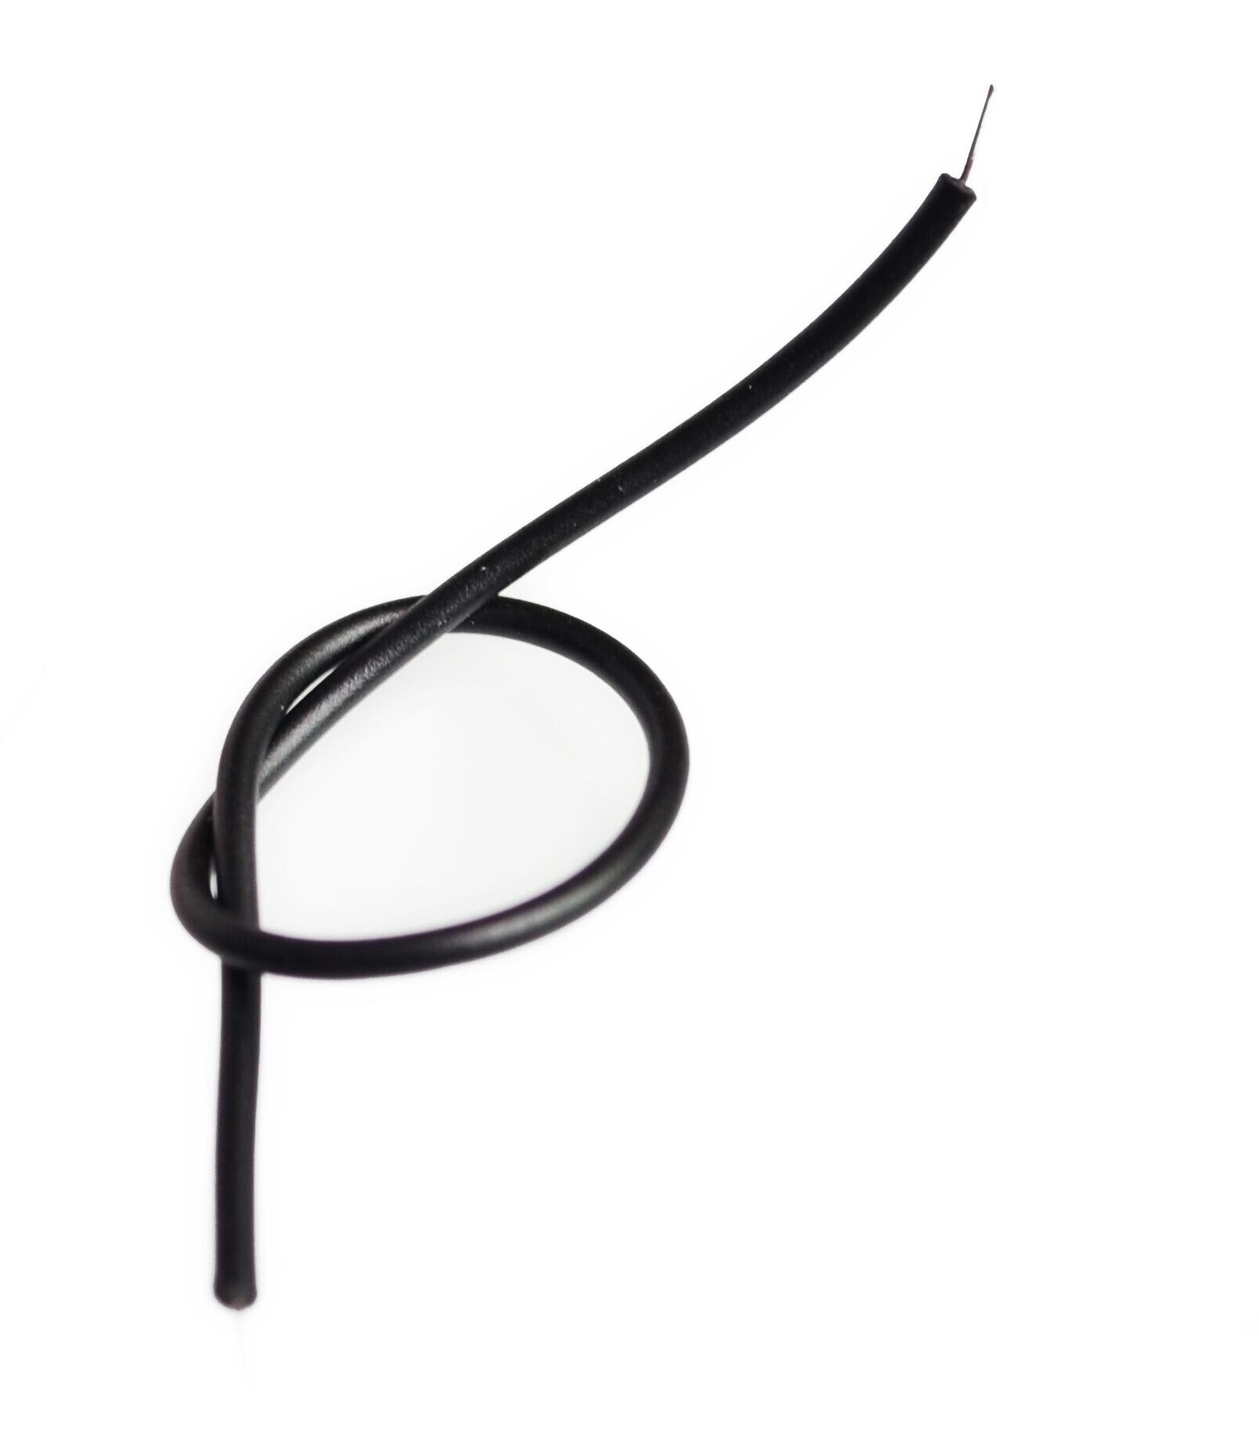

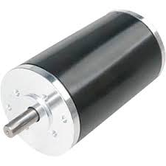
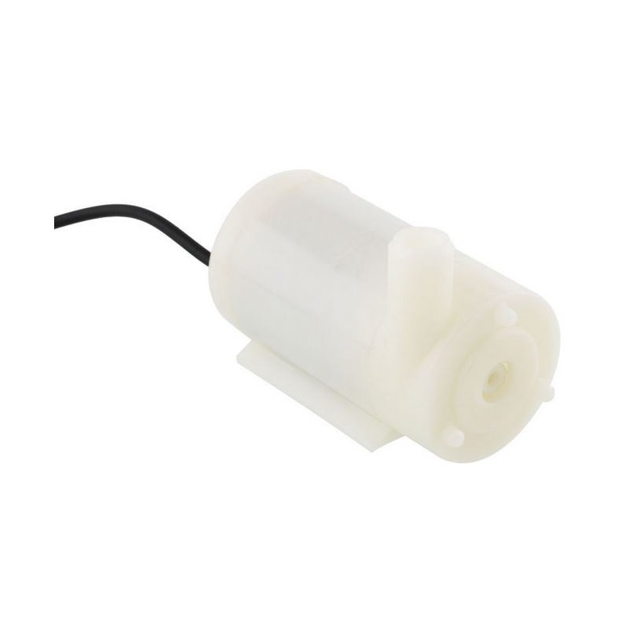
System Parts
01
02
03
04
Arduino UNO
Breadboard
Humidity Sensor
LED
05
06
07
08
Cables
Resistors
DC Motor
Water Pump

Slide 3
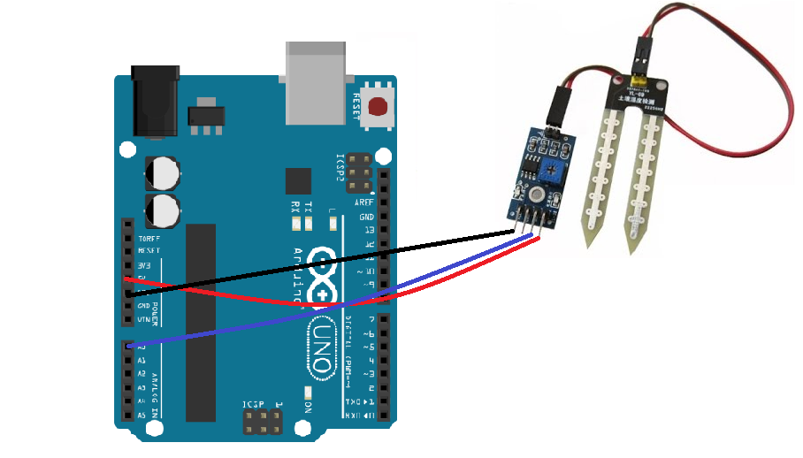
Circuit

Slide 4
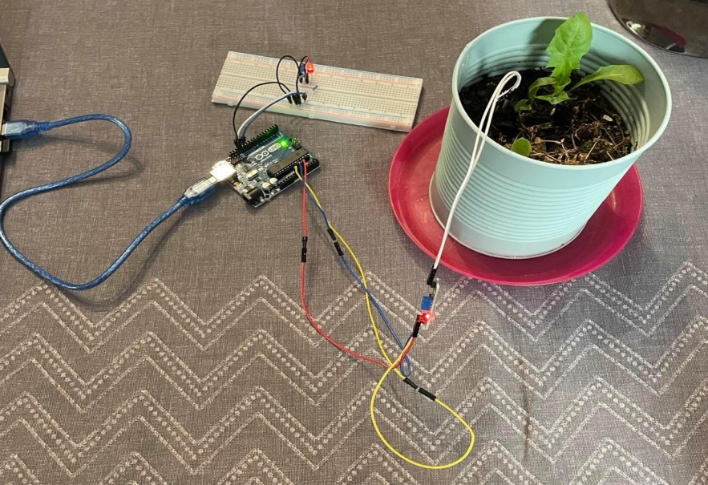
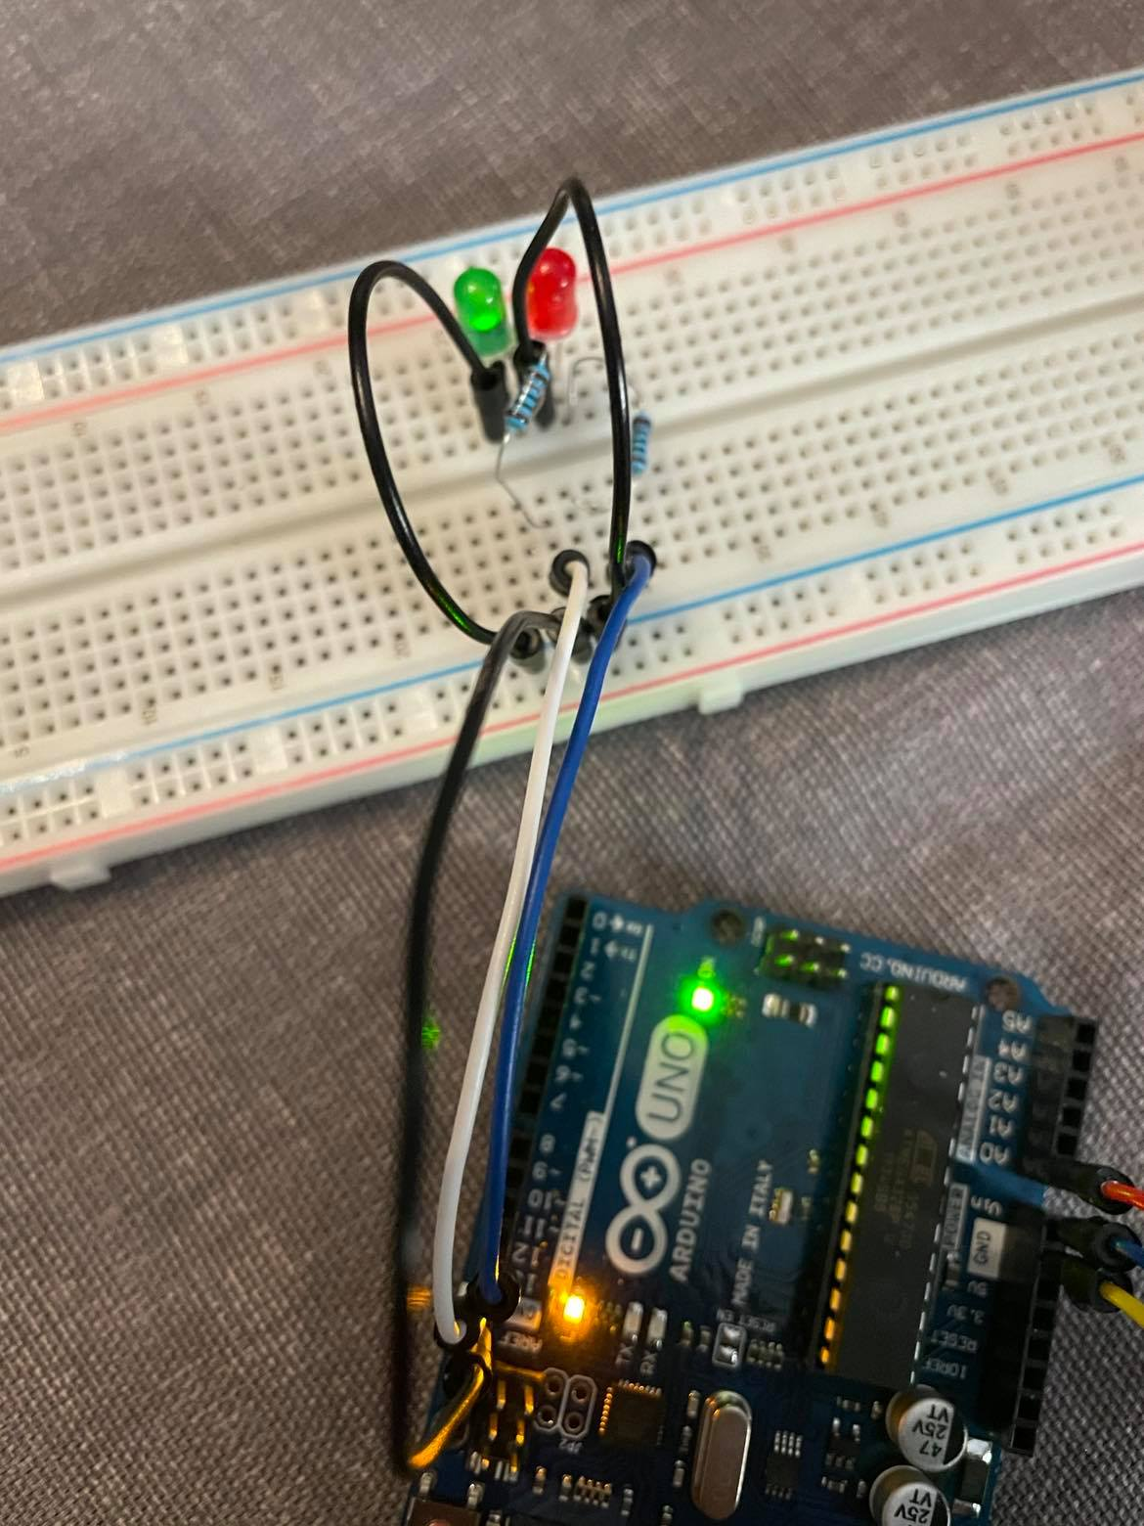
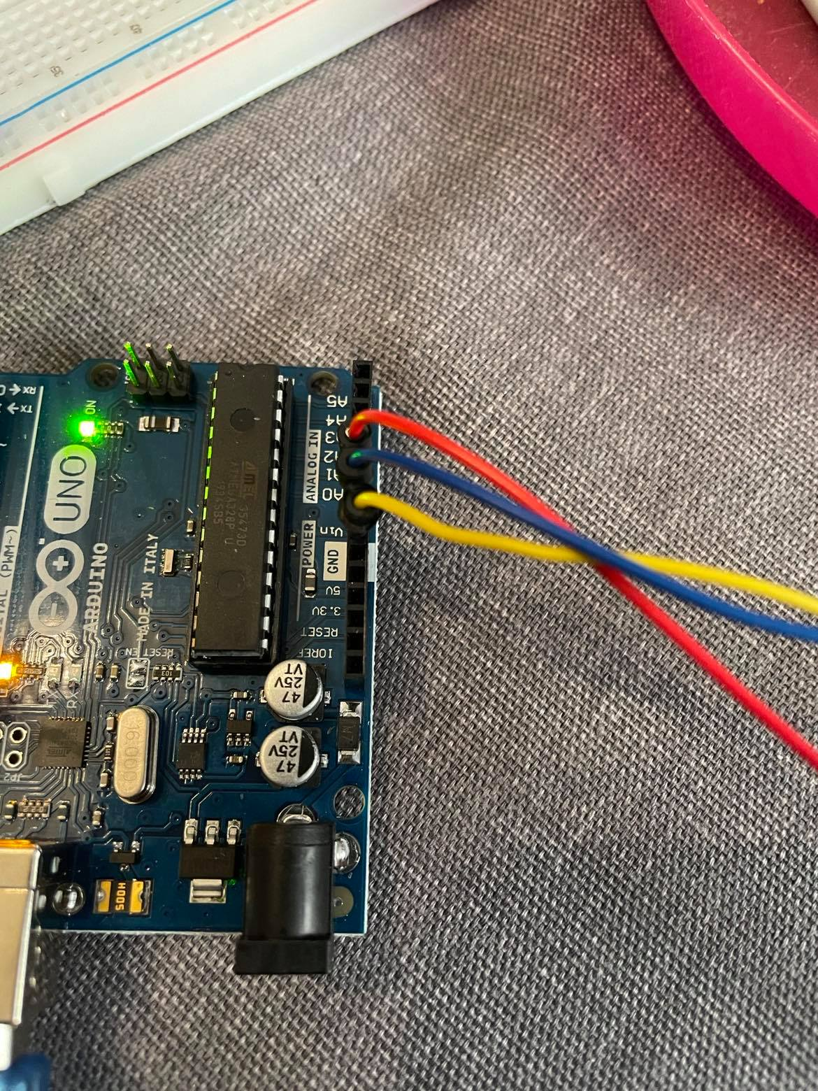
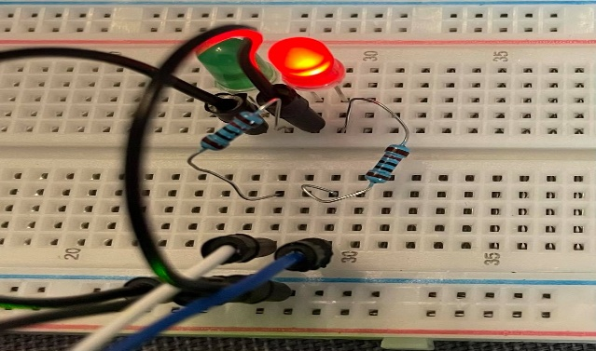
Photo Records

Slide 5
Απαιτήσεις Λογισμικού
Python
Arduino Sketch
PHP-MySQL
Libraries
MySQL connector
Serial
Connect to Arduino Sketch
Connect to database
Uploading data every 6h
Calculating & uploading the average value every 12h
Connect with pinMode()
Sensor
LED
Arduino function loop()
Getting value from sensor
Light up LEDs for predetermined values
Site hosted in local server (XAMPP)
Database hosted in local server
Connection database-site
Database Tables
Average
Value
Show all average values & all today’s values

Slide 6
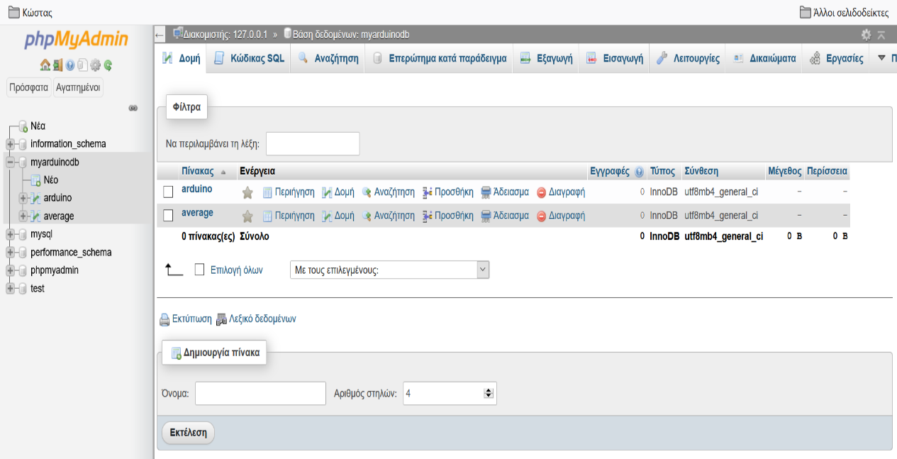
Database

Slide 7
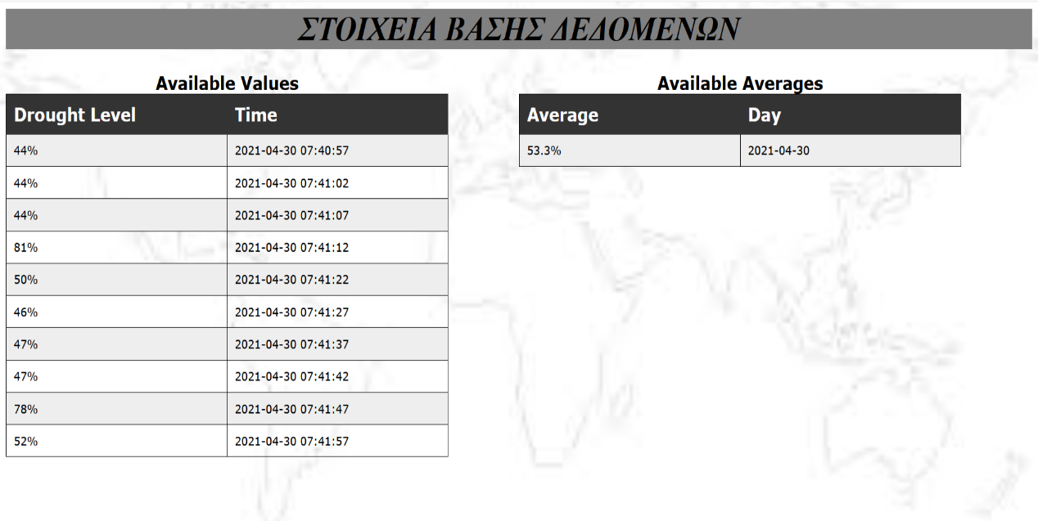
Site
Database Values

Slide 8

Thank you
Contact us: daiXXXXX@uom.edu.gr
Zagoras Konstantinos dai19242
Tsaganidou Maria dai18256

